Slide 1

Use Cases Testing
Lesson 7: Use case Testing

Slide 2
Lesson Objectives
To understand the following topics:
Use case modeling
Advantage of use cases
Actor
Goals and Requirements
Goals and scenarios
Naming Conventions
Alternate Path
Exceptions
Errors
Precondition & Post-condition
Good practices
Failure scenarios

Slide 3
Use Case Usage
7.1: Use case modeling
Use cases help to:
Describe a business process
Capture functional requirements of a system
Document design details of a system
Use Case
An Use Case can be defined as a set of activities performed within a system by a
User
Each Use Case:
describes one logical interaction between the Actor and the system
defines what has changed by the interaction

Slide 4
Use Case Diagrams
7.1: Use case modeling
Use Case Diagrams model the functionality of system by using Actors and Use Cases:
Actor is a user of the system
Use cases are services or functions provided by the system to its users
Actor
Use Case

Slide 5
Drawing The Use Case Diagram
7.1: Use case modeling
A Use Case diagram has the following elements:
Stick figure: representing an Actor
Oval: representing a Use Case
Association lines: representing communication between Actors and Use Cases
Place Order
Request Price
Get Order Status
Customer

Slide 6
Advantages
7.2: Advantage of use cases
Easy to write
Expressed in simple language that user understands
Can be visually represented
Can be used for validation (acceptance testing)
Tools support
Ideal for OO development
Function oriented system (different types of users, complex behavioral patterns)
When Not to use case?
System has few users
System dominated by non-functional requirements

Slide 7
Definition
7.3: Actor
Actor:
An Actor can be described as follows:
Actor is any entity that is external to the system and directly interacts with the
system, thus deriving some benefit from the interaction
Actor can be a human being, a machine, or a software
Actor is a role that a particular user plays while interacting with the system
Examples of Actors are End-user (roles), External systems, and External passive objects (entities)
Type of Actors:
Primary Actor
Initiates the Use Case
Calls on the system to deliver a service
Has a goal with respect to the system
Supporting Actor
provides a service to the system under design

Slide 8
Use Case: Actors and goals
7.3: Actor
A GOAL is:
What an ACTOR wants to get with the help of the system
An ACTION is
what the ACTOR must perform to reach the GOAL
An INTERACTION is
a sequence of steps that must be followed to complete the ACTION

Slide 9

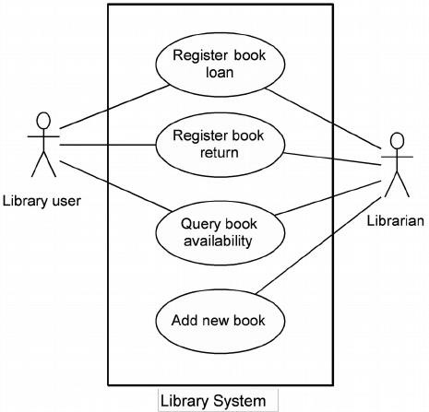
Use Case Diagram –Example 1

Slide 10
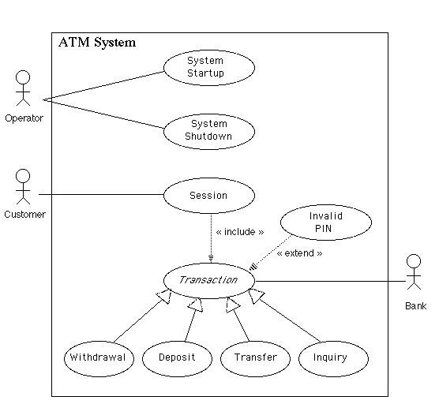
Use Case Diagram –Example 2

Slide 11
Actor
7.3: Actor
Use Cases: Actors And Goals
has
Usecase
Goal
names
contains
calls
Scenario
condition
succeed / fail

Slide 12
Use Cases: Goals And Requirements
7.4: Goals and Requirements
Examining the Goals the system supports makes good functional requirements.
“Place an order.”
“Get money from my bank account.”
“Get a quote.”
“Find the most attractive alternative.”
“Set up an advertising program.”
Goals summarize system function in understandable, verifiable terms of
use.

Slide 13
Use Cases: Goals And Requirements
7.4: Goals and Requirements
Structured narrative keeps the context visible
Just paragraphs:
“ATM system has in interface with Bank database. It verifies the customer details and provides options. …”
With structured narrative:
“Customer swipes the ATM card and enters the pin number. ATM system has an interface with Bank database
to verify the customer pin. The system
displays options to the customer
When? How?

Slide 14
Goals And Scenarios
7.5: Goals and scenarios
A use case pulls goals and scenarios together
In Use Case “ Withdraw money from ATM”
Scenario 1: Everything works well ...
Scenario 2: Customer enters invalid pin …
Scenario 3: Insufficient balance ...
Use case is goal statement plus the scenarios.
Note the grammar for Use Case: active verb first

Slide 15
Use Cases: Naming Actors
7.6: Naming Conventions
Group individuals according to their common use of the system
Identify the roles they take on when they use the system
Each role is a potential actor
Name each role and define its distinguishing characteristics
Do not equate job title with role name. Roles cut across job titles
Use the common name for an existing system; don’t invent a new name
to match its role

Slide 16
Use Cases: Alternative Paths
7.7: Alternate Path
For each significant action:
Is there another significant way to accomplish it that could be taken at this point? (Variation)
Is there something that could go wrong? (Exception)
Is there something that could go really, really wrong (Error)

Slide 17
Use Cases: Exceptions
7.8: Exceptions
Exceptions are deviations from the typical case that happen during the normal course of events
They should be handled, not ignored
How to resolve them can be open to debate What if a user mistypes her password? What if an order can’t be fulfilled?
What if a connection to a web browser is dropped?

Slide 18
Use Cases: Errors
7.9: Errors
Errors are when things unexpectedly go wrong. They can result from malformed data, bad programs or logic errors, or broken hardware
Little can be done easily to “fix things up and proceed”
Recovery requires drastic measures
What if the disk is full?
What if equipment cannot be provisioned?
What if the OS crashes?

Slide 19
Use Cases: Precondition & Postcondition
7.10: Precondition & Postcondition
Precondition
is constraint not the event that starts the use case
state what must always be true before beginning a scenario in use case are not tested within the use case; rather, they are conditions that are assumed to be true
communicate noteworthy assumptions that the use case writer thinks readers
should be alerted to condition to start an execution of test case

Slide 20
Use Cases: Precondition & Postcondition
7.10: Precondition & Postcondition
Post conditions
state what must be true on successful completion of the use case—either the main
success scenario or some alternate path
should be true regardless of which alternative flows were executed
can be a powerful tool for describing use cases
First define what the use case is supposed to achieve, the post condition

Slide 21
Use Cases: Good Practices
7.11: Good practices
Make the use cases clear, short and easy to read
Use active voice, present tense, make sure actor and actor’s intent are
visible in each step
Every Use case has two possible endings: Success and Failure / alternate courses. Gather both
Create a list of primary actors and their goals (actor-goal list)
Restrict use cases to capture system behavior….use cases are not suitable
for other type of requirements

Slide 22
Failure Scenarios
7.12: Failure scenarios
Don’t overlook failure scenarios
“What if their credit is too low?”
“What if they run over the extended credit limit?”
“What if we cannot deliver the quantity?”
“What if data is corrupt in the database?”
(These are commonly overlooked situations)

Slide 23
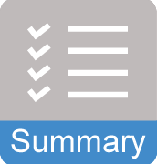
Summary
In this lesson, you have learnt:
The use case model provides a complete, black-box, outside-in view of system functionality.
A use case is a procedure by which an actor may use the system.
A good use case is largely a sequence of interactions across the system boundary between the actor(s) and the system written in easy to understand natural language.
An actor is always outside the system being defined
The actor that starts the use case is the primary actor for that use case
An actor is a role defined by the set of use cases with which it is
associated

Slide 24

Review Question
Question 1: is very effective elicitation technique.
Question 2: Actors live outside the boundary of the system.
Option: True / False
Question 3: Postconditions are basically conditions to start an execution of test case.
Option: True / False

Slide 25
Review Question: Match the Following
1.Precondition
2. Actor
3. Errors
4. Post condition
5. Exception
A. Non-recoverable extensions
B. Expectedly go wrong
C. These are not tested within the use case
D. Unexpectedly go wrong
E. Must be true on successful completion of the use case
F. Live outside the boundary of the system

